Slide 2

Book recommendation system
Vũ Minh Hiếu - 20225494

Slide 3
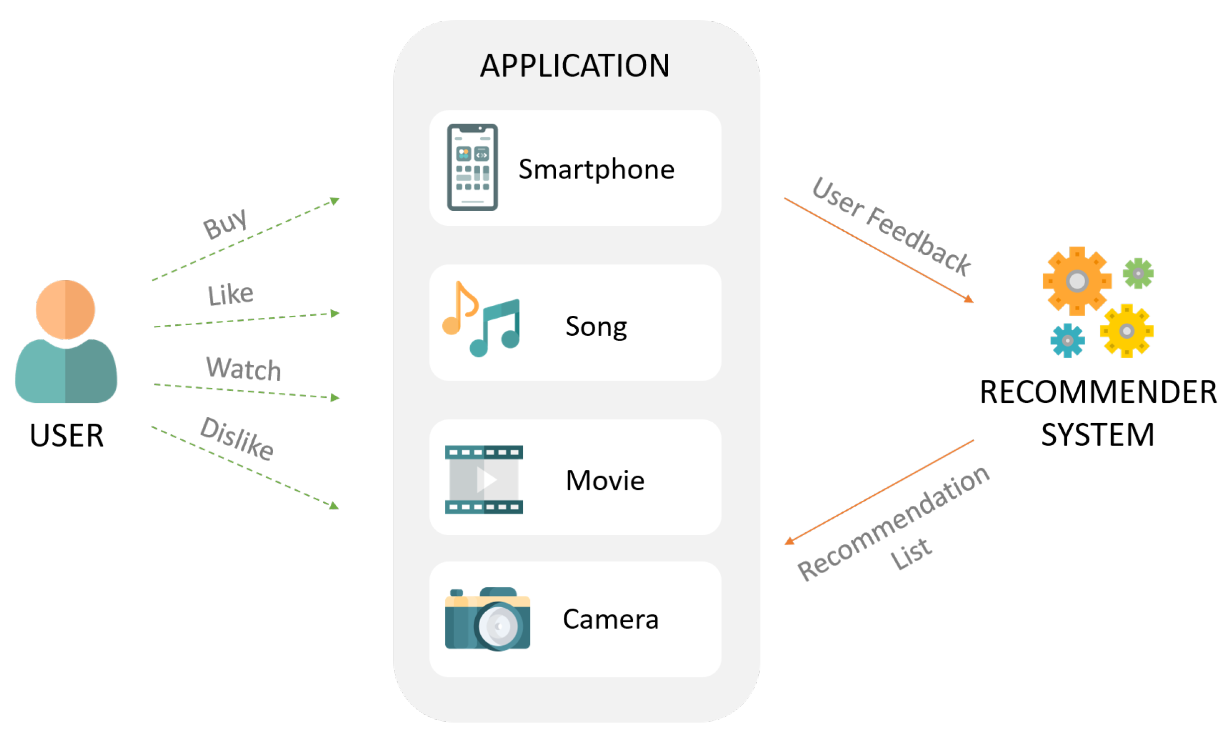
1. Introduction
What is recommendation system?
A class of machine learning that uses data to help predict, what people are looking for among a large number of options.

Slide 4
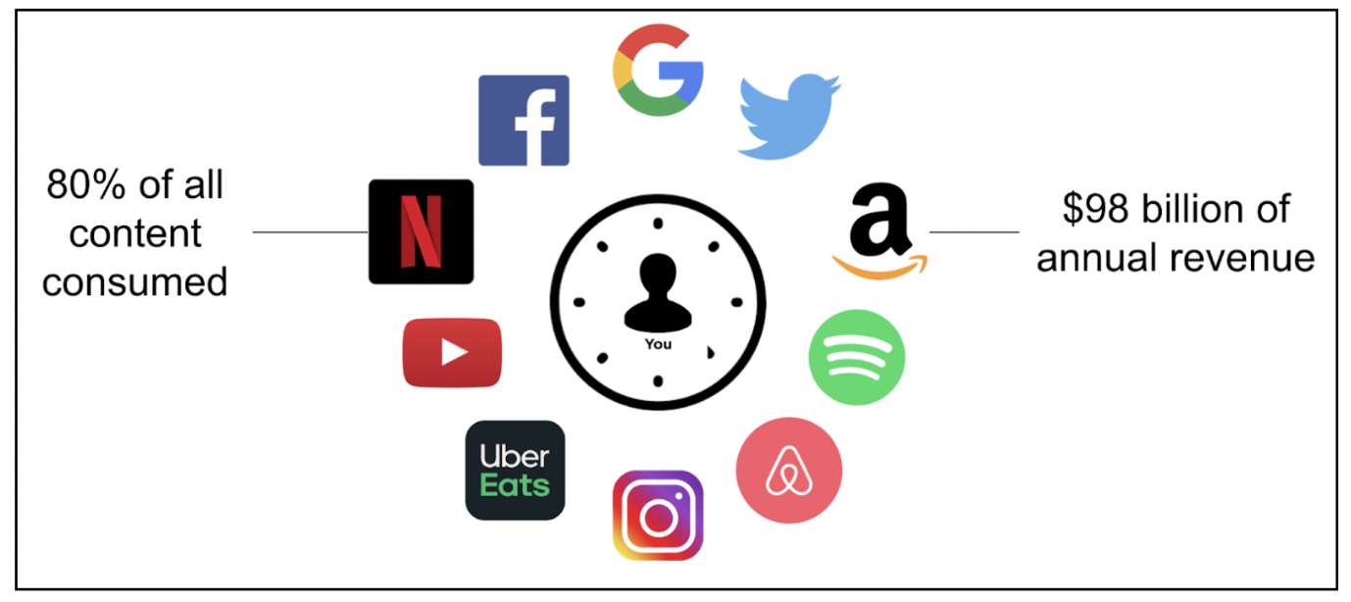
1. Introduction
Why are Recommendation Systems Important?
Helps Users Discover Relevant Content
Enhances User Experience
Increases Business Revenue

Slide 5
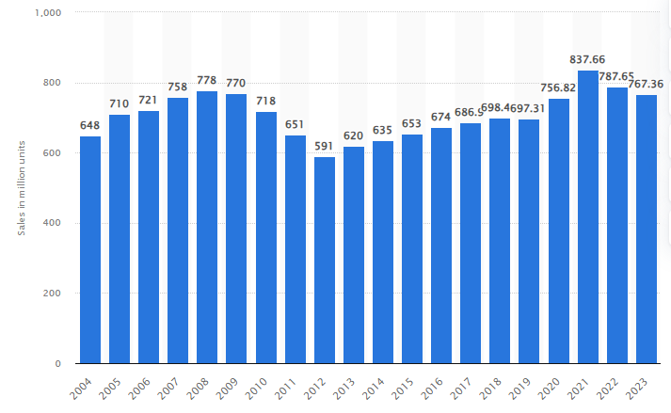

2. Problem Statement
With millions of books available, how can users find books they’ll like?
A book recommendation system is needed
Unit sales of printed books in the United States from 2004 to 2023(in millions)

Slide 6
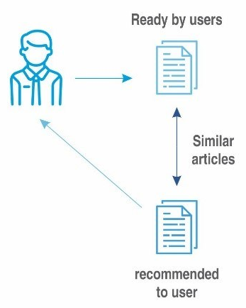
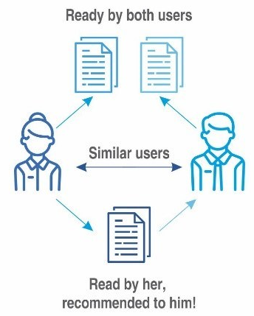
3. Types of Recommendation Systems
Content-Based Filtering
Recommends books based on features (genre, author, description)
Example: If a user likes “Calculus 1," they might get recommendations for “Calculus 2"
Collaborative Filtering
Based on user behavior and preferences of similar users
Example: People who liked data science books also read AI books

Slide 7
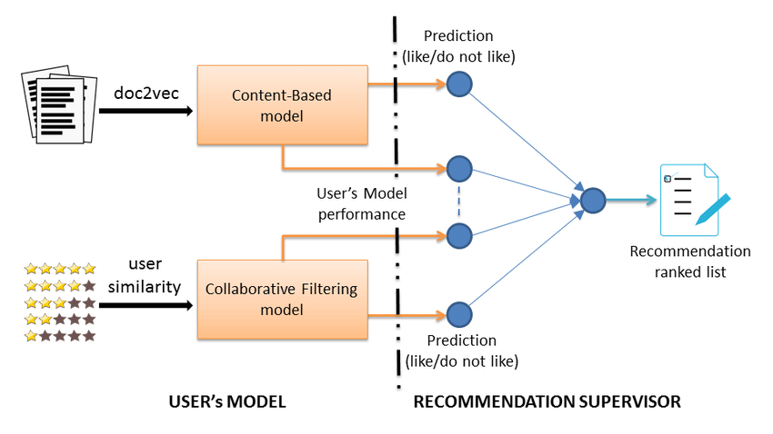
3. Types of Recommendation Systems
Hybrid recommender
collaborative filtering: lack information about the domain dependencies
content-based system: lack information about the people’s preferences in.
=> Combine both methods to get better result.

Slide 8


4. Implementation
Dataset Preparation
Select a dataset (e.g., Goodreads, Amazon reviews…)
Data Preprocessing: Cleaning data, handling missing values

Slide 9
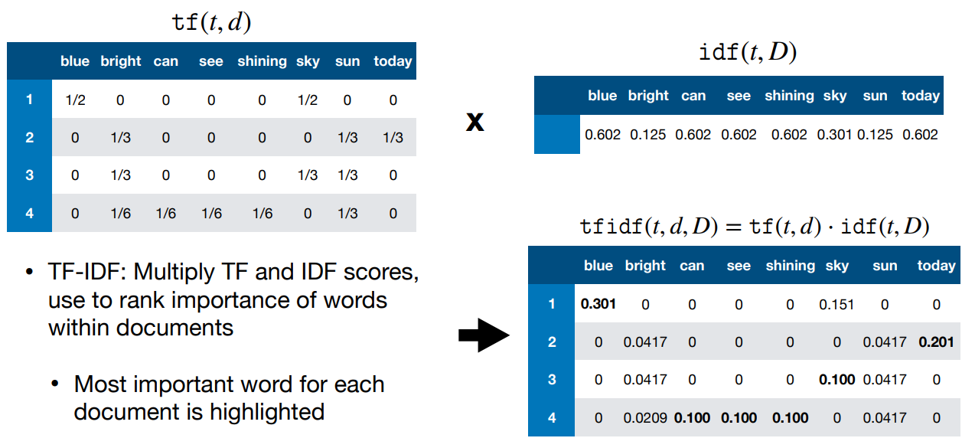
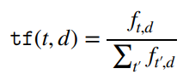
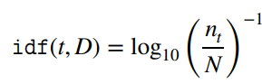
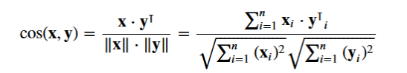
4. Implementation
2. Building the system
2.1 Content-Based Recommender
TF-IDF vector
Compute a similarity score
Dot Product
Cosine similarity

Slide 10
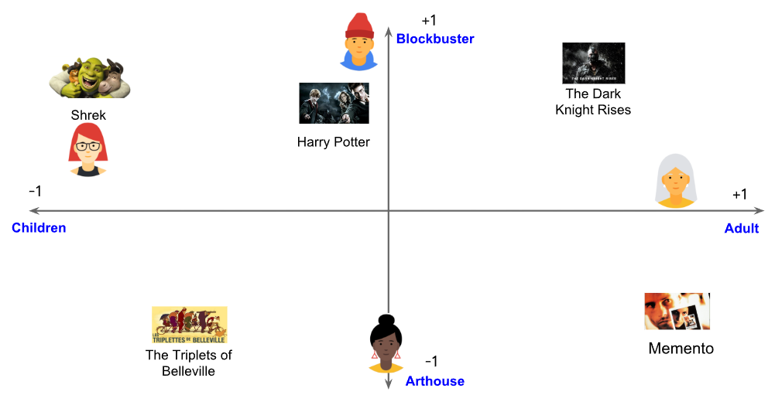
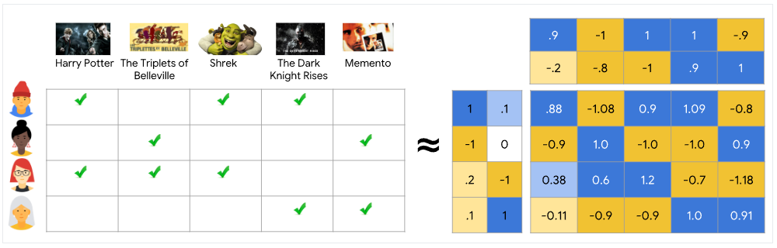
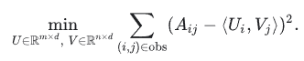
4. Implementation
2. Building the system
2.1 Collaborative Filtering
Construct a user ratings matrix:
Columns: movies
Rows: users
Entries: rating
Perform matrix factorization to learn latent matrixes.
Minimize the sum of squared errors over all pairs of observed entries

Slide 11
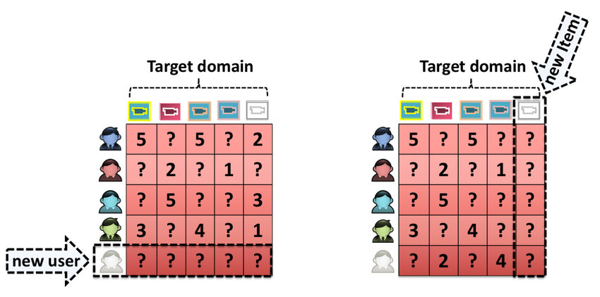
5. Challenges and Limitations
Cold Start Problem (New users or books have no data)
Scalability Issues (Large datasets need optimization)

Slide 12
6. References
https://developers.google.com/machine-learning/recommendation/content-based
Yehuda Koren, Robert Bell, and Chris Volinsky. “Matrix Factorization Techniques for Recommender Systems”. In: (2009).
https://www.datacamp.com/tutorial/recommender-systems-python
https://en.wikipedia.org/wiki/Tf%E2%80%93idf
https://mallahyari.github.io/ml_tutorial/tfidf/

Slide 13
THANK YOU !

